Slide 1
FSMO Roles in Active Directory
By Rosemarie Kpaka

Slide 2

Introduction to Active Directory
Active Directory (AD) is a centralized directory service essential for managing identities, securing access, and supporting IT infrastructure in organizations.
AD organizes and secures information and allows us to control user access to resources.

Slide 3
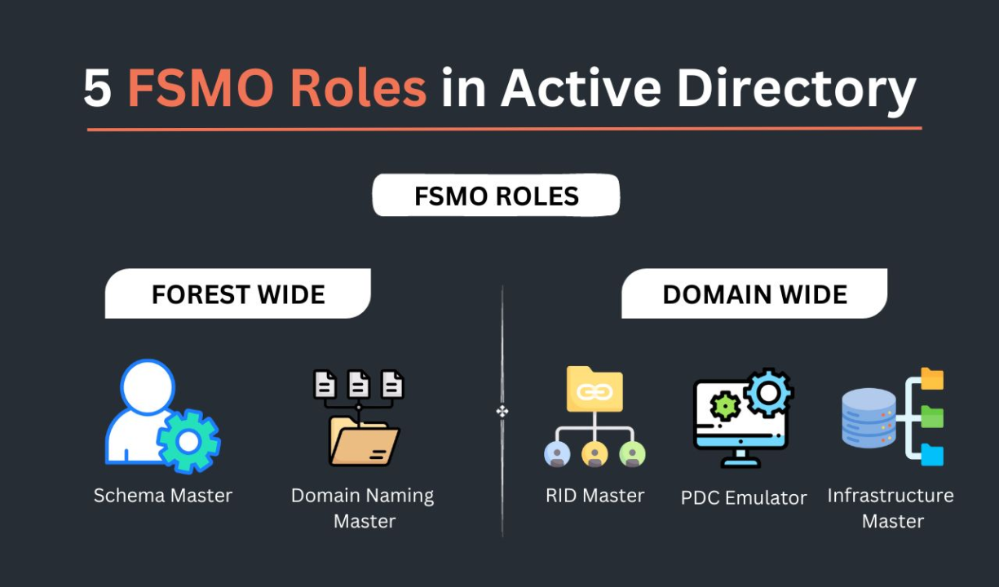
Purpose of FSMO Roles in AD
FSMO (Flexible Single Master Operation) roles help reduce conflicts in Active Directory by assigning specific tasks to designated domain controllers.
These roles are designed to maintain stability, consistency, and data integrity in AD.

Slide 4
Overview of the Five FSMO Roles
AD has five FSMO roles, each with unique responsibilities for managing essential directory operations.

Slide 5
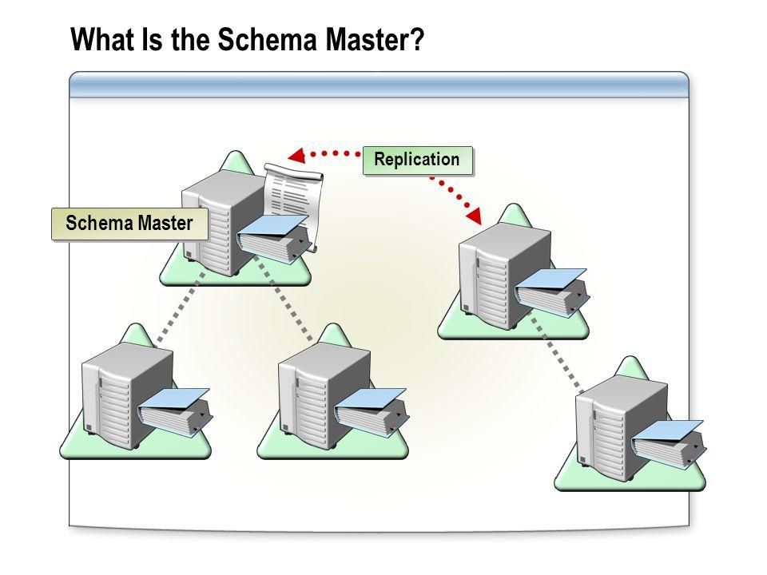
Schema Master Role
The Schema Master role approves changes to the AD schema, ensuring structural consistency across the forest.
Critical for applications and services depending on AD data.

Slide 6
Importance of Schema Master
Maintains a uniform schema for the entire forest, preventing conflicts and schema corruption.
Enables controlled updates to directory attributes used by various systems.

Slide 7
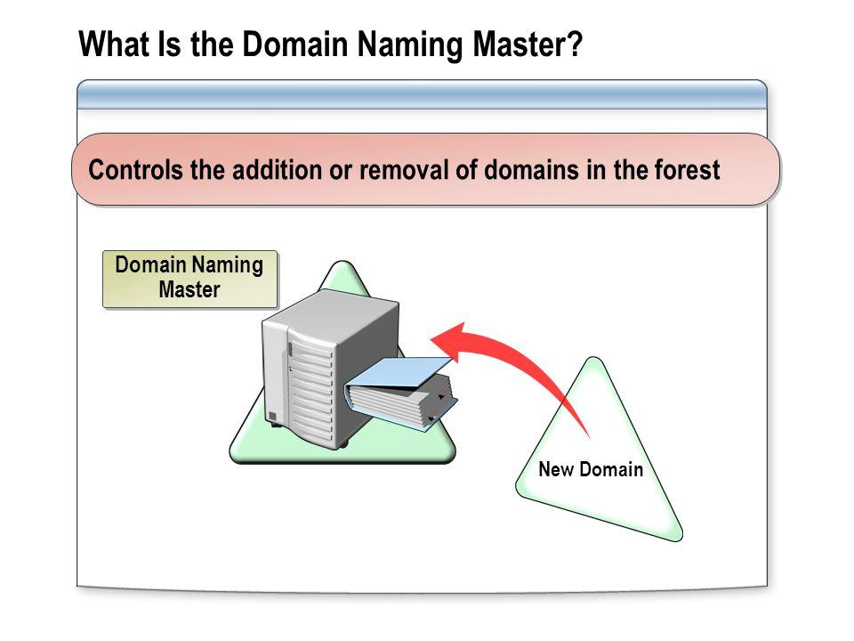
Domain Naming Master Role
The Domain Naming Master role manages the creation and removal of domains in the AD forest.
Prevents domain name conflicts and maintains the forest's namespace integrity.

Slide 8
Importance of Domain Naming Master
Ensures each domain has a unique name, reducing risk of duplication.
Supports expansion and reorganization without disrupting directory operations.

Slide 9
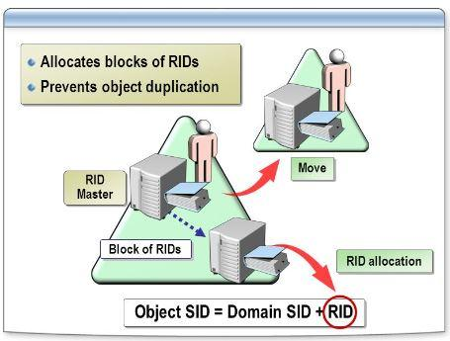
Relative ID (RID) Master Role
The RID Master assigns RID pools to domain controllers for creating unique Security Identifiers (SIDs) for objects.
Essential for security as it helps maintain unique identities within the domain.

Slide 10
Importance of RID Master
Ensures all new objects in the domain have unique SIDs, supporting access control and security protocols.

Slide 11
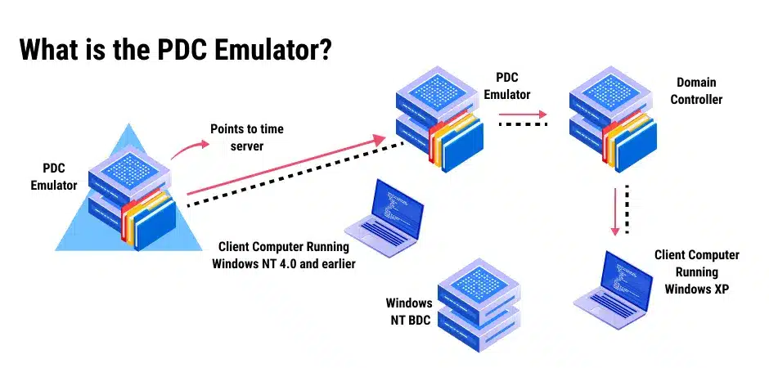
Primary Domain Controller (PDC) Emulator Role
The PDC Emulator manages password changes, time synchronization, and provides legacy support.
Ensures smooth authentication and accurate timekeeping across the domain.

Slide 12
Importance of PDC Emulator
Central for legacy support, password update coordination, and secure, consistent timekeeping for security services.

Slide 13
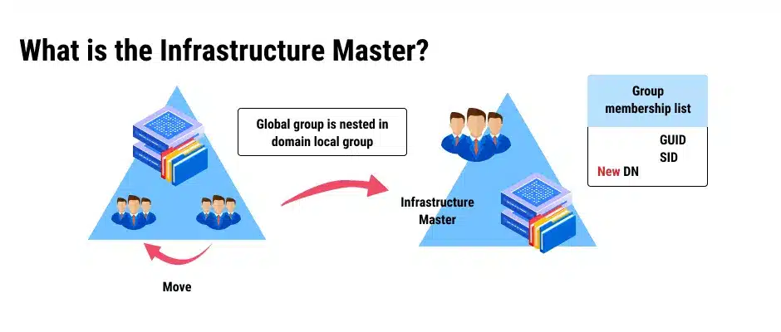
Infrastructure Master Role
Manages cross-domain object references, keeping them updated as objects change.
Essential for maintaining directory consistency and accurate object references.

Slide 14
Importance of Infrastructure Master
Ensures references to objects in other domains remain accurate, preventing directory errors and application issues.

Slide 15
Summary
FSMO roles are essential for the stability, security, and scalability of Active Directory.
By managing specialized tasks, these roles ensure that Active Directory remains a reliable identity solution.

Slide 16
Thank You!
By Rosemarie Kpaka

